Slide 1
CP2404/CP5633 Database Modelling
Lecture 07

Slide 2
Lecture 7
Structured Query Language (SQL)
- Part 2 -
Reading: Coronel’s 12e Chapter 7.5 ~ 7.8
13e Chapter 7.1 ~ 7.7, 8.3 ~ 8.4
Notes:
2

Slide 3
Learning Objectives
In this lecture, you will learn:
How to use SQL for changing the characteristics of a table or a column
How to use SQL query with aggregation functions extract useful information
How to use SQL query which involves 2 or more tables

Slide 4
Note:
Most SQL commands/scripts used in this lecture notes followed the standard ANSI SQL, thus some of them may not be compatible to every DBMS.

Slide 5
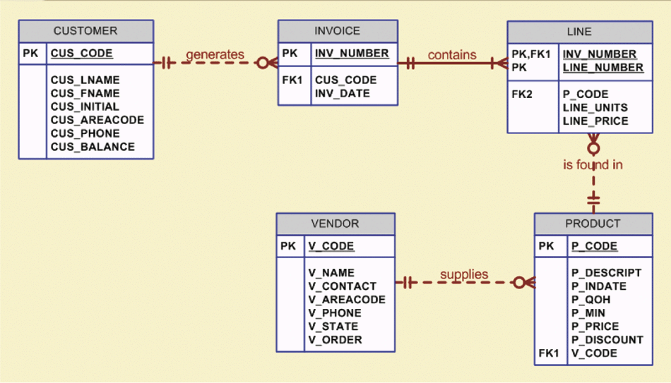
EXAMPLE: The Database Model

Slide 6
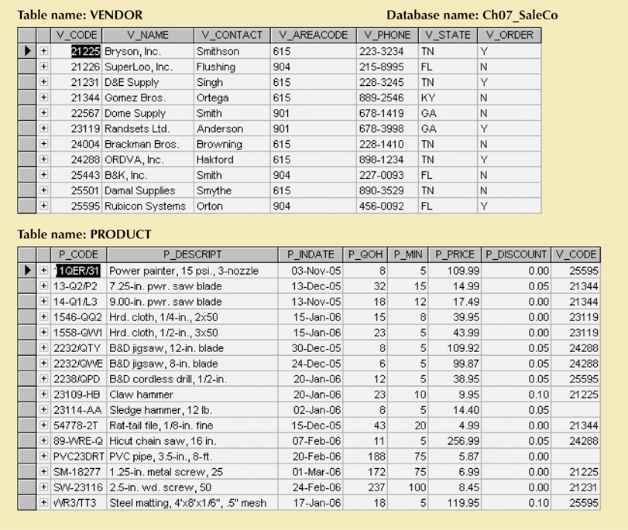
EXAMPLE: The Database Model

Slide 7
Advanced Data Definition Commands
All changes in table structure are made by using ALTER command
Followed by keyword that produces specific change
Following three options are available:
ADD
MODIFY
DROP
ALTER can be used to change data type and characteristics (e.g. length of varchar)‏

Slide 8
Adding and Dropping a Column
Use ALTER to add column
Use ALTER to drop column
ALTER TABLE PRODUCT
ADD P_SALECODE CHAR(1);
ALTER TABLE VENDOR
DROP COLUMN V_ORDER;

Slide 9
Adding and Dropping a Column
Use ALTER to add column
Do not include the NOT NULL clause for new column, WHY ?
Error !!
Use ALTER to drop column
ALTER TABLE PRODUCT
ADD P_SALECODE CHAR(1);
ALTER TABLE PRODUCT
ADD P_SALECODE CHAR(1) NOT NULL;
ALTER TABLE VENDOR
DROP COLUMN V_ORDER;

Slide 10
Adding and Dropping a Column
Use ALTER to add column
Do not include the NOT NULL clause for new column, WHY ?
Error !!
Use ALTER to drop column
ALTER TABLE PRODUCT
ADD P_SALECODE CHAR(1);
ALTER TABLE PRODUCT
MODIFY P_SALECODE NOT NULL;
ALTER TABLE PRODUCT
ADD P_SALECODE CHAR(1) NOT NULL;
ALTER TABLE VENDOR
DROP COLUMN V_ORDER;

Slide 11
Advanced Data Updates
The UPDATE command updates only data in existing rows
For example, to enter the P_SALECODE value ‘2’ in the row with P_CODE ‘1546-QQ2’
UPDATE PRODUCT
SET P_SALECODE = '2'
WHERE P_CODE = '1546-QQ2';

Slide 12
UPDATE Command Examples
UPDATE PRODUCT
SET P_SALECODE = '1'
WHERE P_CODE IN ('2232/QWE', '2232/QTY');
UPDATE PRODUCT
SET P_SALECODE = '2'
WHERE P_INDATE < ‘2005-12-25’;
UPDATE PRODUCT
SET P_SALECODE = '1'
WHERE P_INDATE >= '2006-01-06'
AND P_INDATE < '2006-02-10';
UPDATE PRODUCT
SET P_QOH = P_QOH + 20
WHERE P_CODE = '2232/QWE‘;

Slide 13
Copying Parts of Tables
SQL permits copying contents of selected table columns so that the data need not be reentered manually into newly created table(s)‏
Create the PART table structure
CREATE TABLE PART (
PART_CODE CHAR(8) NOT NULL UNIQUE,
PART_DESCRIPT CHAR(35),
PART_PRICE DECIMAL(8,2),
V_CODE INTEGER,
PRIMARY KEY (PART_CODE));

Slide 14
Copying Parts of Tables
SQL permits copying contents of selected table columns so that the data need not be reentered manually into newly created table(s)‏
Create the PART table structure
Add rows to new PART table using PRODUCT table rows
CREATE TABLE PART (
PART_CODE CHAR(8) NOT NULL UNIQUE,
PART_DESCRIPT CHAR(35),
PART_PRICE DECIMAL(8,2),
V_CODE INTEGER,
PRIMARY KEY (PART_CODE));
INSERT INTO PART (PART_CODE, PART_DESCRIPT, PART_PRICE, V_CODE)‏
SELECT P_CODE, P_DESCRIPT, P_PRICE, V_CODE
FROM PRODUCT;

Slide 15
Create New Table based on Existing Table
→ If the PART table already exists, the DBMS will ask if you want to delete the existing table and continues with the creation of the new PART table
SELECT P_CODE AS PART_CODE,
P_DESCRIPT AS PART_DESCRIPT,
P_PRICE AS PART_PRICE,
V_CODE
INTO PART
FROM PRODUCT;

Slide 16
Adding Primary and Foreign Key Designations
When table is copied
integrity rules do not copy
primary and foreign keys need to be manually defined on new table
Use ALTER TABLE command
Syntax:
ALTER TABLE tablename
ADD PRIMARY KEY (fieldname);
For foreign key, use FOREIGN KEY in place of PRIMARY KEY

Slide 17
Examples of Adding Primary and Foreign Key
To add a PK to the PART table
To add a FK to the PART table
ALTER TABLE PART
ADD PRIMARY KEY(PART_CODE);
ALTER TABLE PART
ADD FOREIGN KEY(V_CODE) REFERENCES VENDOR;

Slide 18
Deleting a Table from the Database
DROP
Deletes table from database
Syntax:
DROP TABLE tablename;
Can drop only a table not in 1 side of 1:M relationship !!
DROP TABLE PART;

Slide 19
Advanced SELECT Queries
SQL query results can be sorted by using the ORDER BY command
SQL provides useful functions that can:
Count
Find minimum and maximum values
Calculate sums or averages
SQL allows user to limit queries to only those entries having no duplicates or entries whose duplicates may be grouped

Slide 20
Ordering a Listing
SELECT P_CODE, P_DESCRIPT, P_INDATE, P_PRICE
FROM PRODUCT
ORDER BY P_PRICE ;
SELECT P_CODE, P_DESCRIPT, P_INDATE, P_PRICE
FROM PRODUCT
ORDER BY P_PRICE DESC ;
SELECT P_DESCRIPT, V_CODE, P_INDATE, P_PRICE
FROM PRODUCT
WHERE P_INDATE < ‘2006-01-21’
AND P_PRICE <= 50.00
ORDER BY V_CODE, P_PRICE DESC ;

Slide 21
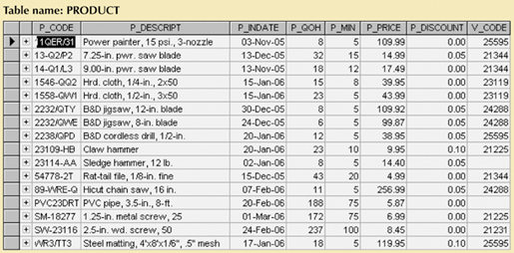
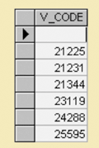
Listing Unique Values
SELECT DISTINCT V_CODE
FROM PRODUCT ;

Slide 22
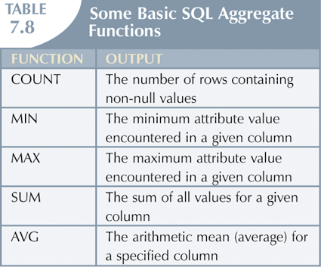
Aggregate Functions
Aggregate functions are very powerful and are used frequently in reporting.

Slide 23
Aggregate Function - COUNT ‏
Q: How many vendors provide products?
COUNT(column) counts the not null values in column
< Oracle or MySQL>
Compare the results of the above query with the following,
SELECT COUNT(*)‏
FROM (
SELECT DISTINCT V_CODE
FROM PRODUCT
WHERE V_CODE IS NOT NULL
);
SELECT COUNT (DISTINCT V_CODE)
FROM PRODUCT
WHERE V_CODE IS NOT NULL;
SELECT COUNT(*)‏
FROM PRODUCT;

Slide 24
SELECT COUNT(*)‏
FROM PRODUCT;

Slide 25
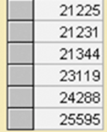
SELECT COUNT (DISTINCT V_CODE)
FROM PRODUCT
WHERE V_CODE IS NOT NULL;
SELECT COUNT(*)‏
FROM (
SELECT DISTINCT V_CODE
FROM PRODUCT
WHERE V_CODE IS NOT NULL
);

Slide 26
Aggregate Functions
Q: How many vendors (unique vendors) have products with price < 10?
Q: How many products with price < 10?
COUNT(*) counts the number of rows returned
SELECT COUNT(*)‏
FROM PRODUCT
WHERE P_PRICE < 10.00;

Slide 27
Aggregate Functions - COUNT
Q: How many vendors (unique vendors) have products with price < 10?
< MySQL>
SELECT COUNT(*)‏
FROM (SELECT DISTINCT(V_CODE)
FROM (
SELECT V_CODE, P_PRICE
FROM PRODUCT
WHERE V_CODE IS NOT NULL AND P_PRICE < 10
) );
SELECT COUNT (DISTINCT V_CODE)
FROM PRODUCT
WHERE V_CODE IS NOT NULL AND P_PRICE<10;

Slide 28
Aggregate Functions – MAX, MIN
MAX and MIN
Q: What product(s) have a price equal to the maximum product price?
SELECT MAX(P_PRICE)
FROM PRODUCT;
SELECT MIN(P_PRICE)
FROM PRODUCT;
SELECT P_CODE, P_DESCRIPT, P_PRICE
FROM PRODUCT
WHERE P_PRICE = (SELECT MAX(P_PRICE)
FROM PRODUCT);

Slide 29
Aggregate Functions - SUM
SUM - computes the total sum for any specified attribute
Q: How much is the total customer balance?
Q: How much is the total value of our product inventory?
SELECT SUM(CUS_BALANCE) AS TOTBALANCE
FROM CUSTOMER;
SELECT SUM(P_QOH*P_PRICE) AS TOTVALUE
FROM PRODUCT

Slide 30
Aggregate Functions - AVG
AVG - compute the average of specific attribute
Q: What is the average product price?
Q: What products have a price that exceeds the average product price?
SELECT AVG(P_PRICE)
FROM PRODUCT;
SELECT P_CODE, P_DESCRIPT, P_QOH, P_PRICE, V_CODE
FROM PRODUCT
WHERE P_PRICE > (SELECT AVG(P_PRICE) FROM PRODUCT)‏
ORDER BY P_PRICE DESC

Slide 31
Grouping Data
GROUP BY clause can be used to create frequency distribution
SELECT P_SALECODE, MIN(P_PRICE)‏
FROM PRODUCT_3
GROUP BY P_SALECODE;
SELECT columlist
FROM tablelist
[WHERE conditionalist
GROUP BY columnlist
HAVING columnlist
ORDER BY columnlist [ ASC | DESC ]];
SELECT P_SALECODE, AVG(P_PRICE)
AS AvgOfP_PRICE
FROM PRODUCT_3
GROUP BY P_SALECODE;
X
SELECT V_CODE, P_CODE, P_DESCRIPT, P_PRICE
FROM PRODUCT_3
GROUP BY V_CODE;

Slide 32
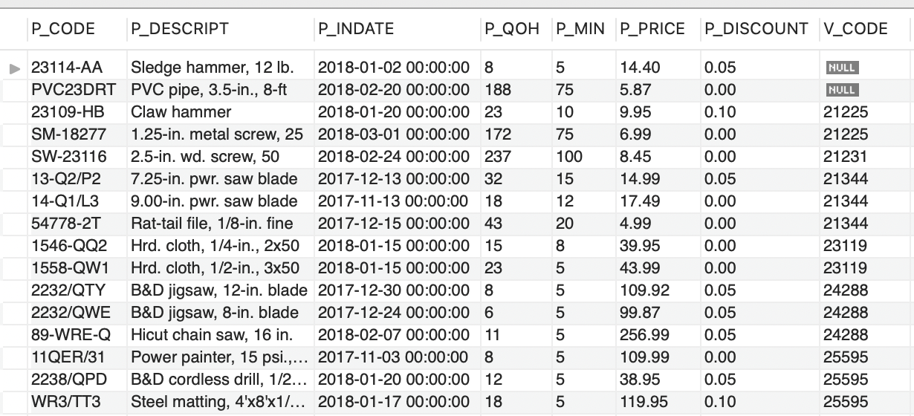
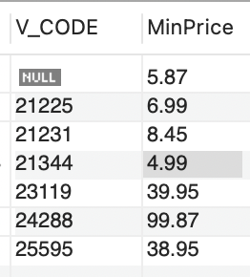
Grouping Data
SELECT V_CODE, MIN(P_PRICE) AS MinPrice‏
FROM PRODUCT
GROUP BY V_CODE;

Slide 33
GROUP BY Feature’s HAVING Clause
HAVING operates like the WHERE clause in the SELECT statement
SELECT V_CODE, Count(P_CODE) AS CountOfP_CODE,
Avg(P_PRICE) AS AvgOfP_PRICE
FROM PRODUCT_3
GROUP BY V_CODE;
SELECT V_CODE, Count(P_CODE) AS CountOfP_CODE,
Avg(P_PRICE) AS AvgOfP_PRICE
FROM PRODUCT_3
GROUP BY V_CODE
HAVING Avg(P_PRICE)<10;

Slide 34

GROUP BY Feature’s HAVING Clause
The HAVING clause operates very much like the WHERE clause in the SELECT statement.
However, the WHERE clause applies to columns and expressions for individual rows,
whereas the HAVING clause is applied to the output of a GROUP BY operation.
SELECT V_CODE, COUNT(P_CODE) AS NUMPRODS
FROM PRODUCT
WHERE AVG(P_PRICE) < 10
GROUP BY V_CODE
HAVING AVG(P_PRICE) < 10
ORDER BY V_CODE;
X

Slide 35
Joining Database Tables
Ability to combine (join) tables on common attributes is most important distinction between relational database and other databases
Join is performed when data are retrieved from more than one table at a time
Join is generally composed of an equality comparison between foreign key and primary key of related tables

Slide 36
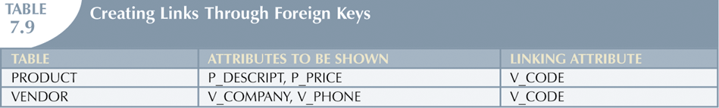
Joining Database Tables
Q: List the product description, price, vendor company name, and phone
for each product
SELECT P_DESCRIPT, P_PRICE, V_COMPANY, V_PHONE
FROM VENDOR, PRODUCT
WHERE VENDOR.V_CODE = PRODUCT.V_CODE;

Slide 37
List products with vendor data for products purchased after 15/Jan/2006.
(List the result in the order of
P_PRICE)
SELECT P_DESCRIPT, P_PRICE, V_CODE, V_NAME, V_PHONE
FROM PRODUCT, VENDOR
WHERE VENDOR.V_CODE = PRODUCT.V_CODE
AND P_INDATE>’2006-01-15’
ORDER BY PRODUCT.P_PRICE;

Slide 38
List all invoice data (customer, invoice number, date, product) for customer number 10014
SELECT CUS_LNAME, INVOICE.INV_NUMBER, INV_DATE, P_DESCRIPT
FROM CUSTOMER, INVOICE, LINE, PRODUCT
WHERE CUSTOMER.CUS_CODE = INVOICE.CUS_CODE
AND INVOICE.INV_NUMBER = LINE.INV_NUMBER
AND LINE.P_CODE = PRODUCT.P_CODE
AND CUSTOMER.CUS_CODE = 10014
ORDER BY INVOICE.INV_NUMBER

Slide 39
Joining Tables with an Alias
Alias can be used to identify source table
Any legal table name can be used as alias
Add alias after table name in FROM clause
FROM tablename alias
SELECT P_DESCRIPT, P_PRICE, V_NAME, V_CONTACT,
V_AREACODE, V_PHONE
FROM PRODUCT AS P, VENDOR AS V
WHERE P.V_CODE = V.V_CODE
ORDER BY P_PRICE
AS is not required for many DBMSs

Slide 40
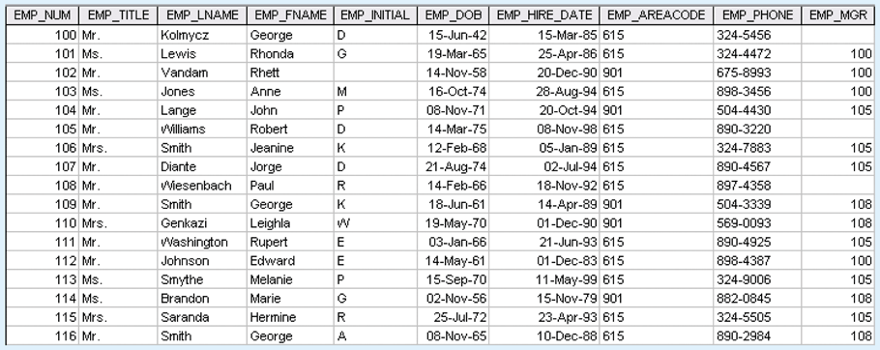
Recursive Joins
Recursive joins, table joined to itself
Q: List all employees with their manager's name

Slide 41
Recursive Joins
Recursive joins, table joined to itself
Q: List all employees with their manager's name
SELECT E.EMP_MGR, M.EMP_LNAME, E.EMP_NUM, E.EMP_LNAME
FROM EMP E, EMP M
WHERE E.EMP_MGR=M.EMP_NUM
ORDER BY E.EMP_MGR
EMP (employee)
EMP (manager)
Join

Slide 42
Outer Joins
An outer join returns not only the rows matching the join condition (that is, rows with matching values in the common columns), it returns the rows with unmatched values.
The left and right designations reflect the order in which the tables are processed by the DBMS.
The LEFT outer JOIN returns not only the rows matching the join condition (that is, rows with matching values in the common column), it returns the rows in the left table with unmatched values in the right table.
The RIGHT outer JOIN returns not only the rows matching the join condition (that is, rows with matching values in the common column), it returns the rows in the right table with unmatched values in the left table.

Slide 43
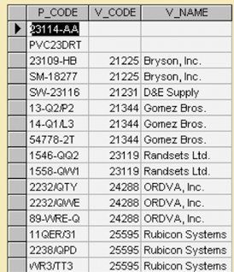
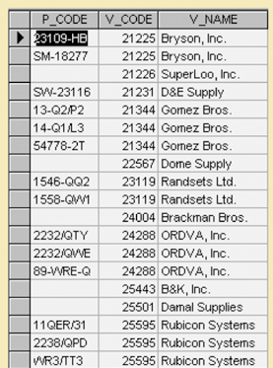
Outer Joins
There are two types of outer joins:
LEFT JOIN and RIGHT JOIN
SELECT PRODUCT.P_CODE, VENDOR.V_CODE,
VENDOR.V_NAME
FROM VENDOR LEFT JOIN PRODUCT
ON VENDOR.V_CODE = PRODUCT.V_CODE;
SELECT PRODUCT.P_CODE, VENDOR.V_CODE,
VENDOR.V_NAME
FROM VENDOR RIGHT JOIN PRODUCT
ON VENDOR.V_CODE = PRODUCT.V_CODE;

Slide 44
Put it all together…..
You can combine multiple clauses and aggregate functions.
SELECT VENDOR.V_CODE, V_NAME, SUM(P_QOH*P_PRICE) AS TOTCOST
FROM PRODUCT JOIN VENDOR ON PRODUCT.V_CODE = VENDOR.V_CODE
WHERE P_DISCOUNT>0
GROUP BY V_CODE, V_NAME
HAVING TOTCOST>500;
This statement does the following:
Joins the product and vendor tables using V_CODE as the common attribute
Restricts to only the rows with a discount greater than 0
Groups the remaining rows into collections based on V_CODE and V_NAME
Aggregates the total cost of products in each group
Restricts to only the groups with totals that exceed $500
Lists the results in descending order by the total cost

Slide 45
Summary
ALTER commands are use to change table structures and column characteristics
Aggregation functions such as COUNT, MINX MAX, AVG can be use to perform arithmetic computations over a set of rows
JOIN can be use to retrieve data from more that one table

Slide 46
SQL In-Class Exercises

Slide 47
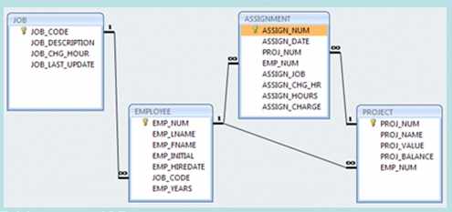

SELECT PROJ_NAME, PROJ_VALUE, PROJ_BALANCE,
EMPLOYEE.EMP_LNAME, EMP_FNAME, EMP_INITIAL,
EMPLOYEE.JOB_CODE, JOB.JOB_DESCRIPTION,
JOB.JOB_CHG_HOUR
FROM PROJECT, EMPLOYEE, JOB
WHERE EMPLOYEE.EMP_NUM = PROJECT.EMP_NUM
AND JOB.JOB_CODE = EMPLOYEE.JOB_CODE;

Slide 48
SELECT PROJ_NAME, PROJ_VALUE, PROJ_BALANCE,
EMPLOYEE.EMP_LNAME, EMP_FNAME, EMP_INITIAL,
EMPLOYEE.JOB_CODE, JOB.JOB_DESCRIPTION,
JOB.JOB_CHG_HOUR
FROM PROJECT, ASSIGNMENT, EMPLOYEE, JOB
WHERE EMPLOYEE.EMP_NUM = ASSIGNMENT.EMP_NUM
AND ASSIGNMENT.PROJ_NUM = PROJECT.PROJ_NUM
AND JOB.JOB_CODE = EMPLOYEE.JOB_CODE;
How about this?
What’s the difference between this code and the previous code?

